Slide 1
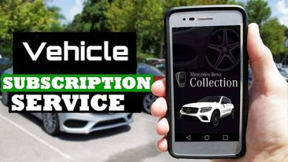
Travel Design
The better way to enjoy your journey
Team Members:
1. Md. Abu Ammar - 1821944642
2. Sadia Afrin Tamanna- 1812030042
3. Tamalika Bakshi- 1812469042

Slide 2
What is vehicle subscription service?
Vehicle subscription service is such a service that allows subscribers to pay a monthly subscription fee to use a variety of vehicles without having to actually own any of them. Usually subscription-service users aren’t limited to just one particular vehicle, and many services also cover costs like insurance and maintenance. Vehicles are usually delivered to subscribers and can be kept for a period of time.

Slide 3
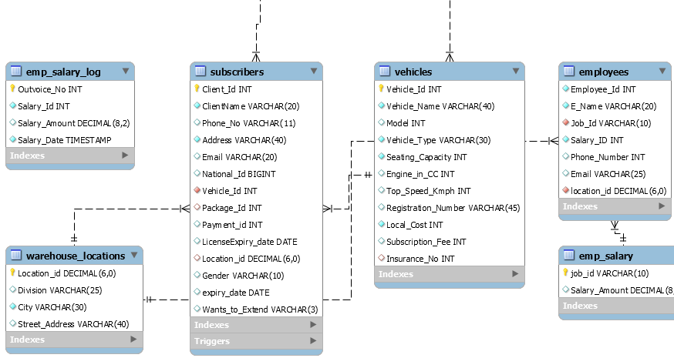
ER Diagram:
Database designers, programmers, and end-users view the data and its use differently. To solve this problem we need to have a model for communication like ER Diagram.
ER model will be following the steps -
➔ Identify important data called entities
➔ Identify relationships between data
➔ Identify attributes of entities
➔ Identify constraints on entities, relationships and attributes
From this part of diagram, we can see that subscribers table has relation with warehouse location with the attribute “Location_Id” and vehicles with “Vehicle_Id”. On the other hand, employees table has relation with emp_salary table with the attribute of “Job_Id” and Warehouse with “Location_Id”.

Slide 4
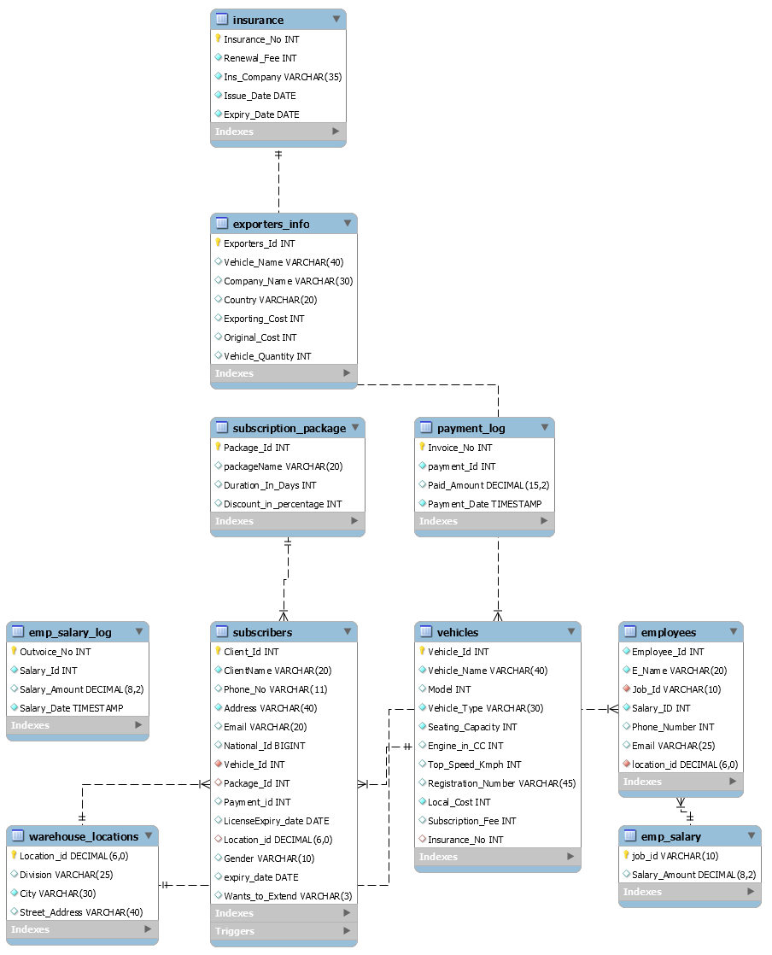

Slide 5
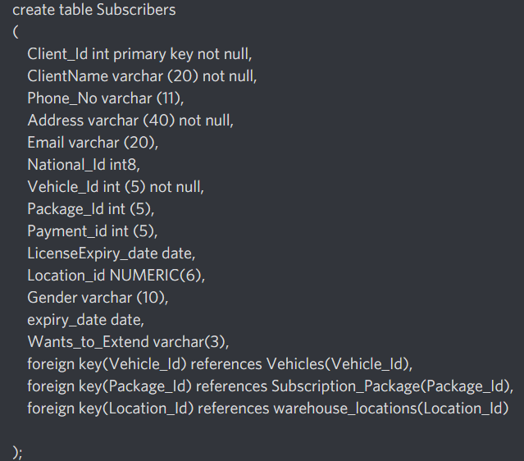
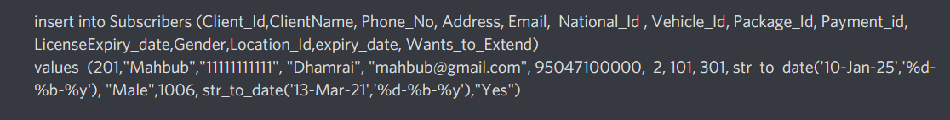
Table Creation And Data Population Example: Required Tables: 1.Subscribers 2.Vehicles 3.Employees 4.Warehouse Locations 5.Insurance 6.Exporters_Info 7.Subscription_Package 8.Emp_Salary 9.Emp_salary_log 10.Payment_Log

Slide 6
Table Details
Subscribers:
In this table, we recorded subscribers name, id, phone number, nid, driving license and other some contact info of the subscribers.
Vehicles:
We recorded some different features of vehicles like model, type, seating capacities including subscription fees, reg no etc in this table.
Employees:
To maintain the service, company needs several employees in different job position in different warehouses so we recorded their info like name, job_id, with unique salary_id etc.
Warehouse_Locations:
To provide vehicles to the customer simultaneously in different places, we need some warehouses. Here we recorded the info like division, location_id etc.
Insurance:
To safeguard our vehicles from unexpected accident we need to ensure insurance of every vehicles and in this table we recorded insurance_no, renewal_fee etc.

Slide 7
Exporters_Info:
To record the expenses bringing a vehicle from different country of different exporters we created this table. Here we recorded company_name, country, exporting cost of vehicles etc.
Subscription_Package:
To provide discount to customers we designed some packages based on the duration of time. In this packages we recorded packages name, Duration_in_days etc,
Emp_Salary:
To record the salary amount of different job position of the employees we created this table.
Emp_Salary_Log:
Every transaction going towards employees will be automatically be recorded with unique outvoice_no.
Payment_Log:
Transaction of subscribers will be recorded automatically with unique invoice_no

Slide 8
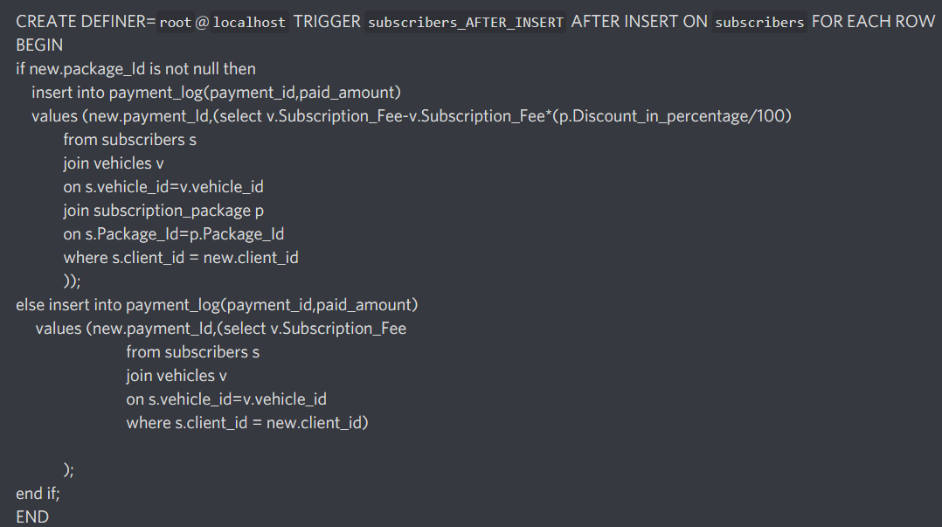
In this project our goals are : 1) When any subscriber subscribed any vehicle his transaction info will be automatically recorded by using “After Insert” trigger .

Slide 9
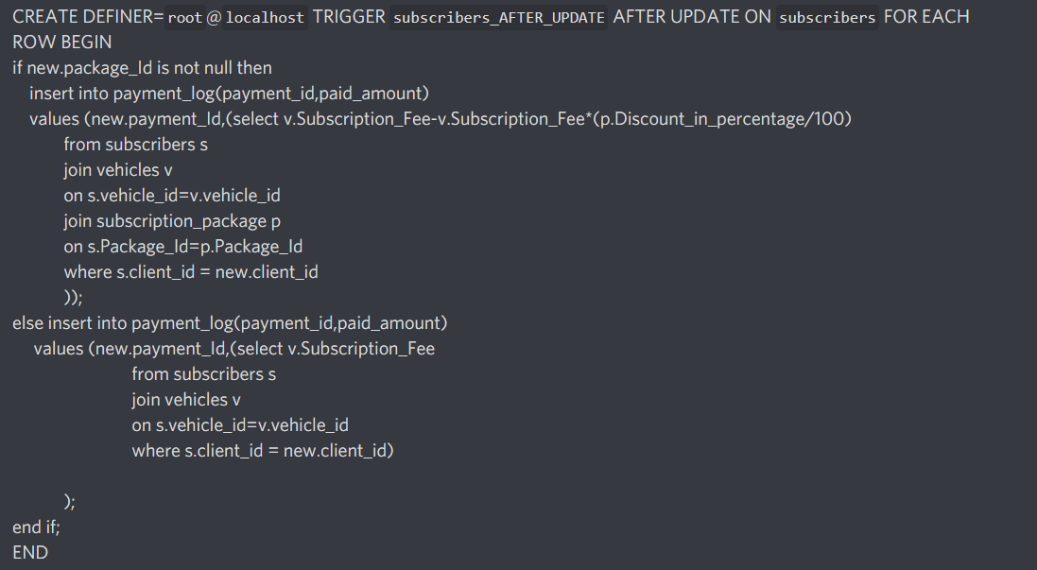
2) When any customer renew his/her subscription period then their new transaction will also be recorded automatically by after updating trigger.

Slide 10
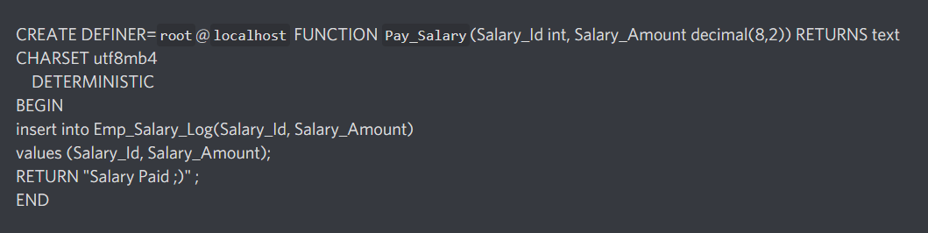
3)We can give the salary to any of our employee by the following function and its also will be automatically recorded in our database:

Slide 11
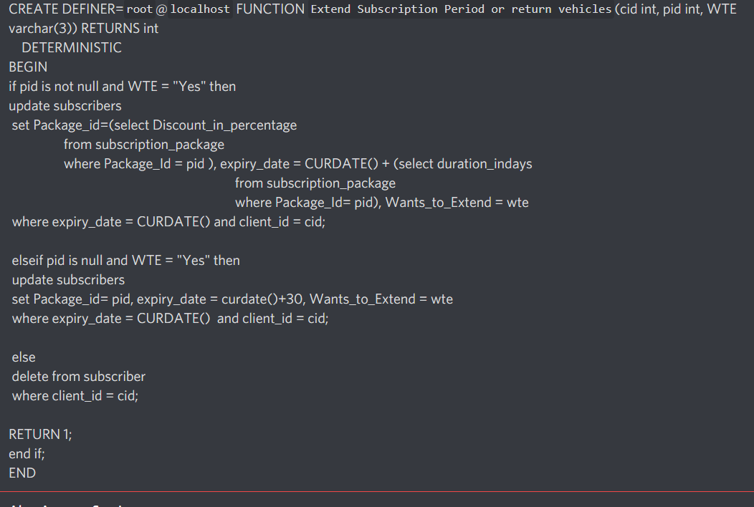
3) If the subscription period ends, a subscriber has a option to renew his subscription period, with or without package, otherwise they will have to return the vehicle.

Slide 12
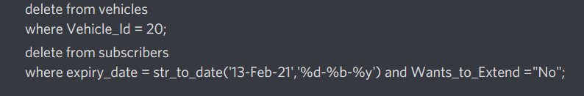

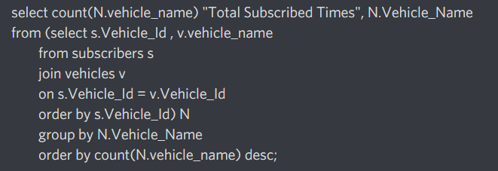
-- Delete test -- If a vehicle is no longer available for our campany. ---If subscription period ends. -- updating subscription fees -- Most demanding Cars

Slide 13
Conclusion
The process of creating a design of project for a database that will support the enterprise operations and objectives. In this project, our goal was to implement such a service by DBMS that we can provide their desired vehicles of customers for a certain period so that they can easily afford a desired vehicle and enjoy their rides. So, we created this “vehicle subscription service” by DBMS in MySQL and with normalization technique we were able to design the database without any anomalies.

Slide 14

Thank you
Any question ??

